Slide 1
Sibyls Fellowship
Outrageous Grace
25/03/2022

Slide 2
Welcome
In Matthew 18: (19-21) Jesus said: “Again, I tell you truly that if two of you on the earth agree about anything you ask for, it will be done for you by God in heaven. For where two or three gather together in my name, there am I with them”.
Then Peter came to Jesus and asked, “Lord, how many times shall I forgive my brother who sins against me? Up to seven times?”
Jesus answered, “I tell you, not just seven times, but seventy-seven times”
In grace and forgiveness let us come together in the love of Christ

Slide 3
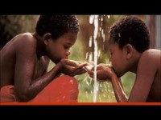
Outrageous Grace

Slide 4
1 Peter 4:7-11
The end of all things is near. Therefore be alert and of sober mind so that you may pray. Above all, love each other deeply, because love covers over a multitude of sins. Offer hospitality to one another without grumbling. Each of you should use whatever gift you have received to serve others, as faithful stewards of God’s grace in its various forms. If anyone speaks, they should do so as one who speaks the very words of God. If anyone serves, they should do so with the strength God provides, so that in all things God may be praised through Jesus Christ. To God be the glory and the power for ever and ever. Amen.

Slide 5
Reflection
Outrageous Grace
Rev Shanon Eli Ferguson

Slide 6
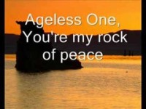
Faithful One

Slide 7
Community Prayers
Let us call out to God now sharing our wants, needs, joys and sorrows for ourselves and the world, knowing that we can depend on Gods outrageous grace.

Slide 8

He Giveth More Grace

Slide 9
Community Sharing
When Jesus walked amongst us He took the time to listen to people and be a part of their lives.
As part of our worship tonight we now will also take the time to listen to one another so even though far apart in distance we can become one in spirit.

Slide 10
Benediction and Grace
Loving God, May we all find a communion of ideal being and perfect grace. May our love for one another reach the level of each day’s quiet need.
By sun and by candlelight may we love freely and always strive for what is right; may we love purely; may we find the strength to meet adversity, tolerance when we meet prejudice, reverence for the beauty of your creation, respect for truth, and faith for the times of uncertainty that will come our way.
And may the outrageous grace of God, the love of Christ and the fellowship of the Holy Spirit be with us now and always. Amen

Slide 11
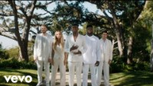
Amazing Grace

